Slide 1
Software Health Management
Instructor: Zonghua Gu
Notes:
Software Fault Protection with ARINC 653, Allen Goldberg, 2007
Jean-Charles Fabre, Marc-Olivier Killijian, François Taïani: Robustness of automotive applications using reflective computing: lessons learnt. SAC 2011: 230-235
Miruna Stoicescu, Jean-Charles Fabre, Matthieu Roy: Architecting Resilient Computing Systems: Overall Approach and Open Issues. SERENE 2011: 48-62
Jean-Charles Fabre, Marc-Olivier Killijian, Thomas Pareaud: Towards On-line Adaptation of Fault Tolerance Mechanisms. EDCC 2010: 45-54
Caroline Lu, Jean-Charles Fabre, Marc-Olivier Killijian: Robustness of Modular Multi-layered Software in the Automotive Domain: a Wrapping-based Approach. ETFA 2009: 1-8

Slide 2
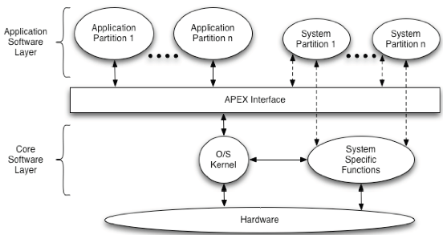
ARINC 653 Architecture
ARINC 653 standard defines an Application Executive, or APEX, which provides OS and middleware services for Integrated Modular Avionics.
Temporal partitioning: TDMA scheduling of partitions

Slide 3
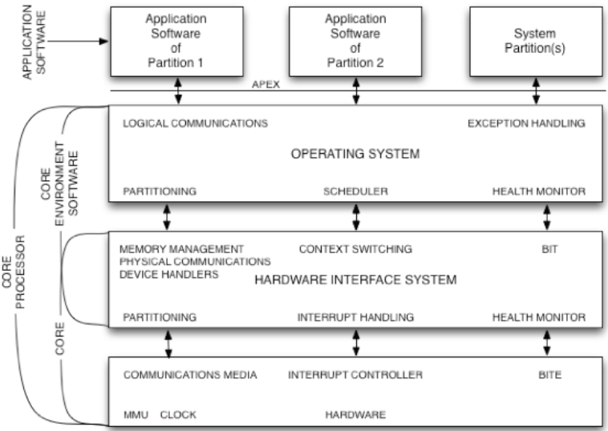
ARINC 653 Layers

Slide 4
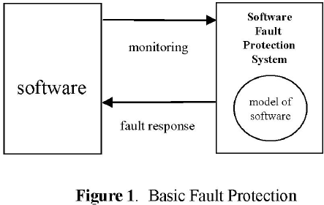
Health Monitoring in ARINC 653
ARINC 653 provides a health monitoring capability intended to detect and respond to both hardware and software faults at the process, partition, module, and system levels.
Fault response is done by looking up the System Health Management (HM) Tables, which is indexed by errorId and system state.

Slide 5
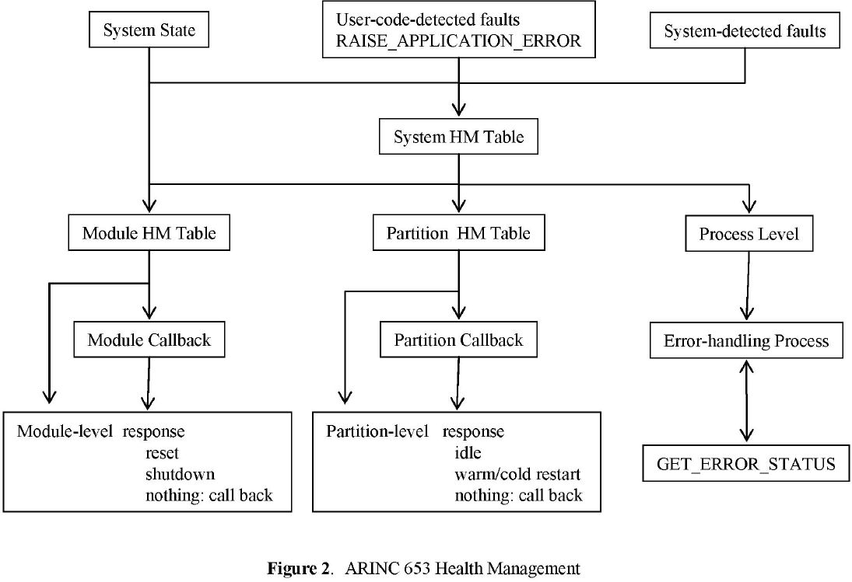
ARINC 653 HM

Slide 6
MODEL-BASED SOFTWARE HEALTH MANAGEMENT
NASA Cooperative Agreement NNX08AY49A
Abhishek Dubey, Gabor Karsai, Nag Mahadevan, Vanderbilt University

Slide 7
Problem Statement
Embedded software is a complex engineering artifact that can have latent faults, uncaught by testing and verification. Such faults become apparent during operation when unforeseen modes and/or (system) faults appear.
The problem:
How to construct a Software Health Management system that detects such faults, isolates their source/s, prognosticates their progression, and takes mitigation actions in the system context?
Notes:
•Specific: How to specify, design, and implement such a system using a model-based framework?
The larger picture:
•General: Software Health Management must be integrated with System Health Management – ‘Software Health Effects’ must be understood on the System (Vehicle) Level.

Slide 8
Key Ideas
Use software components as units of fault management: detection, diagnosis, and mitigation
Components must be observable, provide fault isolation, and be capable of mitigation
Use a two-level architecture:
Component level: detect anomalies and mitigate locally
System level: received anomaly reports, isolate faulty component(s), and mitigate on the component
Use models to represent
anomalous conditions
fault cascades
mitigation actions (when / what)
Use model-based generators to synthesize code artifacts
Developer can use higher-level abstractions to design and implement the software health management functions of a system

Slide 9
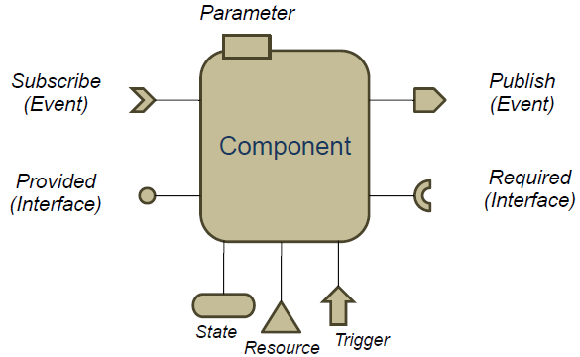
Component Model
A component is a unit (containing potentially many objects). The component is parameterized, has state, it consumes resources, publishes and subscribes to events, provides interfaces and requires interfaces from other components.
Publish/Subscribe: Event-driven, asynchronous communication
Required/Provided: Synchronous communication using call/return semantics.
Triggering can be periodic or sporadic.

Slide 10
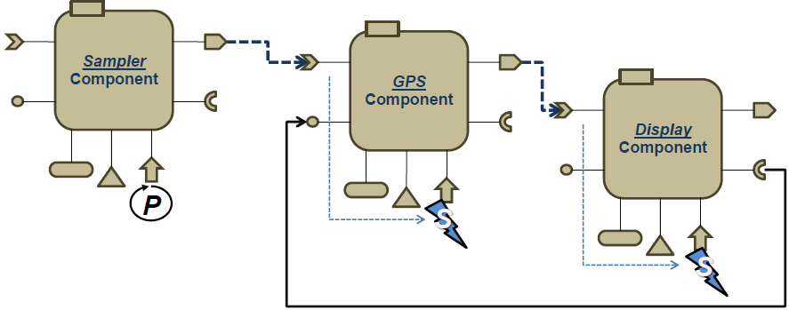
Component Interactions
Components can interact via asynchronous/event-triggered and synchronous/call-driven connections.
Example: The Sampler component is triggered periodically and it publishes an event upon each activation. The GPS component subscribes to this event and is triggered sporadically to obtain GPS data from the receiver, and when ready it publishes its own output event. The Display component is triggered sporadically via this event and it uses a required interface to retrieve the position data from the GPS component.

Slide 11
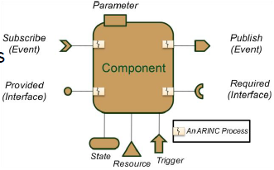
ACM: The ARINC Component Model
Each ‘input interface’ has its own process
Process must obtain read-write/lock on component
Asynchronous publisher (subscriber) interface:
Listener (publisher) process
Pushes (receives) one event (a struct), with a validity flag
Can be event-triggered or time-triggered (i.e. 4 variations)
Synchronous provided (required) interface:
Handles incoming synchronous RMI call
Forwards outgoing synchronous RMI call
Other interfaces:
State: to observe component state variables
Resource: to monitor resource usage
Trigger: to monitor execution timing

Slide 12
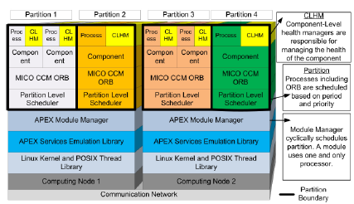
ACM Implementation
ARINC-653 Emulator
Emulates APEX services using Linux API-s
Partition→Process, Process→Thread
Module manager: schedules partition set
Partition level scheduler: schedules threads within partition
Based on CCM (CORBA Component Model)
Notes:
Mainly implemented via APEX
•RMI interactions use threads

Slide 13
Health Management
What are the components?
Component model
How do we monitor them?
Monitor interfaces
How do we detect anomalies?
Based on specs for anomalous/correct behavior
How do we mitigate?
React to detection events / current state of health manager
Notes:
How do we implement all these?
–Use a modeling language + generate code as needed

Slide 14
CLHM & SLHM
Component-level health management: (CLHM) provides localized and limited functionality for managing the health of one component by detecting anomalies, mitigating its effects using a reactive timed state machine – on the level of individual components. It also reports to higher-level SLHM
System-Level Health Manager (SLHM) manages the overall health of the system i.e. assembly of all components.

Slide 15
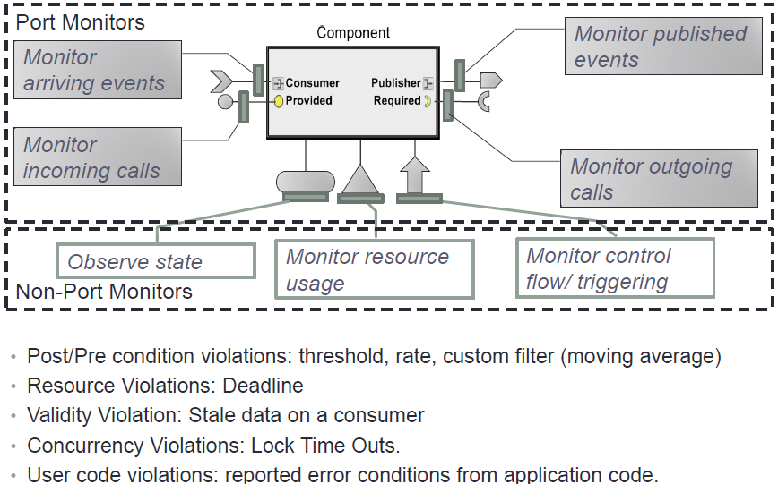
Component Monitoring

Slide 16
Component Monitoring Cont’
Purpose: to detect anomalies in the context of components.
Component monitoring must happen on the ‘right’ level of abstraction such that meaningful conditions for the component’s health could be formulated.
Monitor events: trigger on the appearance of the event, access data associated with the event (if any)
Monitor interfaces: trigger on the execution of the method call, before and after execution of the method, access call parameters
Observe state: query values of state variables.
Monitor resource usage: keep track of dynamic and stack memory usage, and keep track of generic resource allocation/de-allocation operations (including timing)
Monitor control flow/triggering: detect invocation and return, keep track of timing (execution time, invocation frequency)
Notes:
Low-level, packet-oriented monitoring is ineffective.
Goal: Minimally intrusive monitoring – as little overhead as possible.

Slide 17
Basic Component Monitoring
Monitor:
method execution time
pre- and post-condition on methods
code execution for exceptions
Conditions are defined over values and rates of method parameters and component state variables
Insufficient to determine whether the component is invoked correctly or whether it is in a correct state.
Example: Component c supports operations x(),y(),z() and the legal sequences of these operations are expressed using the following regular expression: ( x; y+; z; )*
Pre/post conditions are insufficient

Slide 18
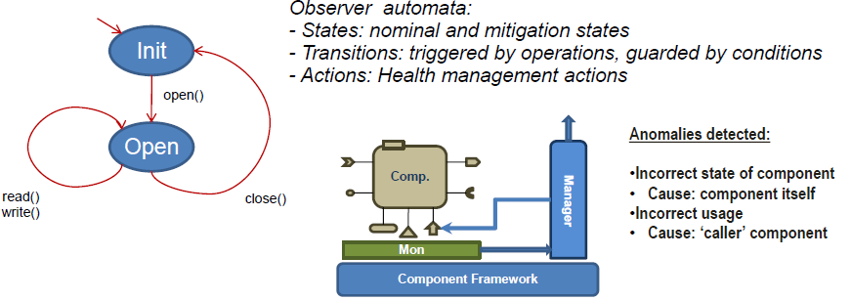
Extended Component Monitoring
Extended component monitoring:
Track component state with an observer automata
The observer automata can also capture the fault mitigation logic
Example: ‘File’ component
Legal sequences of operations start with an open(), followed by arbitrary number of read() or write() operations, followed by a close().

Slide 19
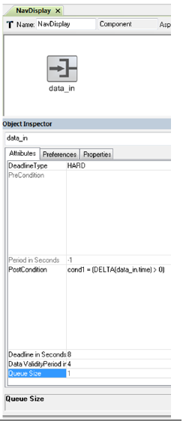
ACM Modeling Language: Monitoring
Monitoring on component interfaces
Subscriber port→‘Subscriber process’ and
Publisher port→‘Publisher process’
Monitor: pre-conditions and post-conditions
On subscriber: Data validity (‘age’ of data)
Deadline (hard / soft)
Provided interface→‘Provider methods’ and
Required interface →‘Required methods’
Monitor: pre-conditions and post-conditions
Deadline (hard / soft)
Monitoring language:
Simple, named expressions over input (output) parameters, component state, delta(var), and rate(var,dt). The expression yields a Boolean condition.
Notes:
–Can be specified on a per-component basis

Slide 20
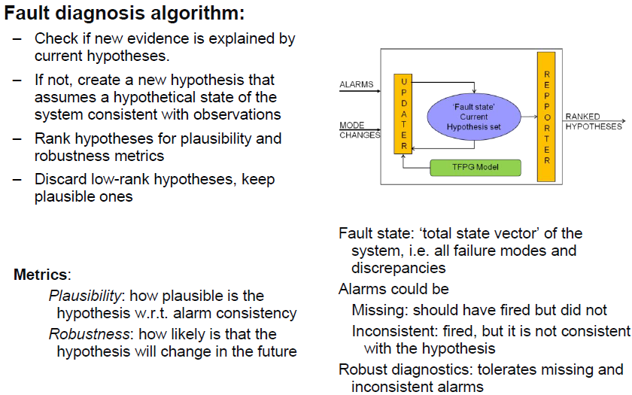
Fault Diagnosis
Notes:
Diagnosis engine uses TFPG-model to hypothesize the fault-source(s) that could have triggered a specific set of alarms.
It is possible that the observed alarm set (observable discrepancies) could be explained by multiple hypotheses (fault source).
Thresholds based on hypothesis metrics such as Plausibility and Robustness are used to prune the hypotheses set.

Slide 21
Timed Failure Propagation Graph (TFPG)
TFPGs are causal models that capture the temporal characteristics of failure propagation in dynamic systems.
Nodes represent either failure modes (fault causes), or discrepancies (off-nominal conditions that are the effects of failure modes).
Edges between nodes capture the propagation of the failure effect
Used to derive efficient reasoning algorithms that implement fault diagnostics:
fault source identification by tracing observed discrepancies back to their originating failure modes.

Slide 22
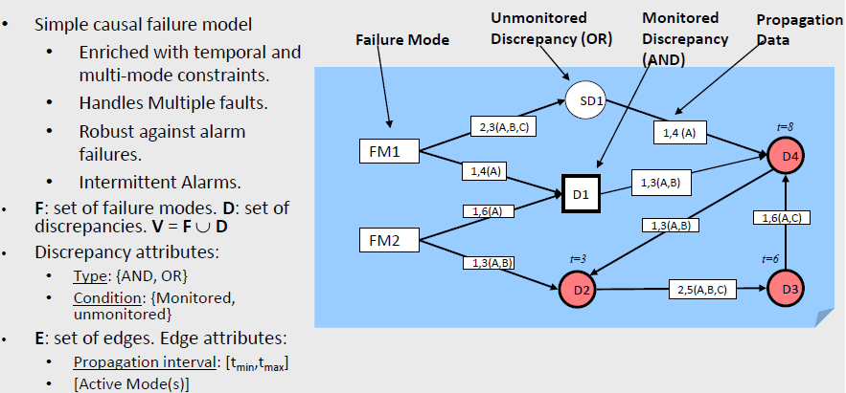
TFPG Example

Slide 23
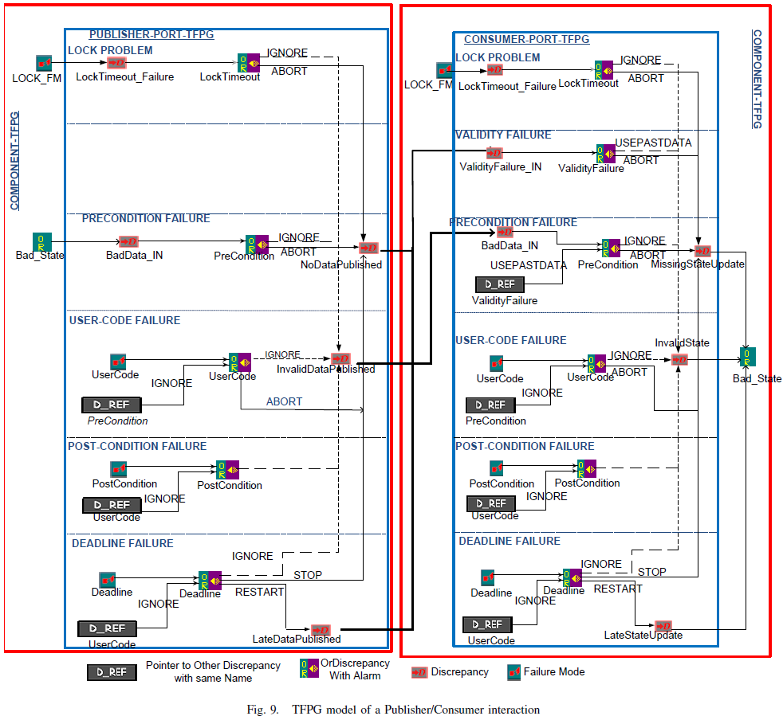
TFPG Model of a Publisher/Subscriber Interaction

Slide 24
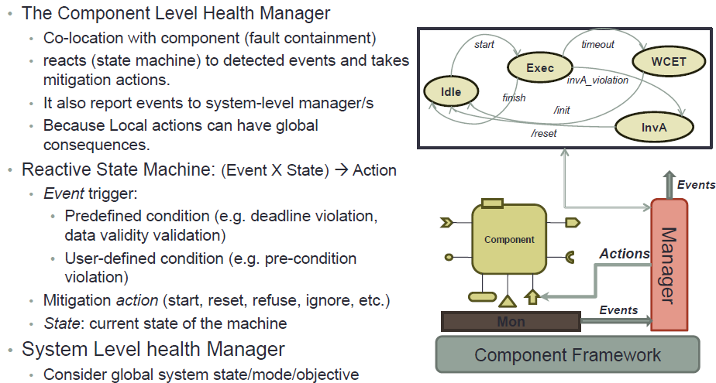
CLHM

Slide 25
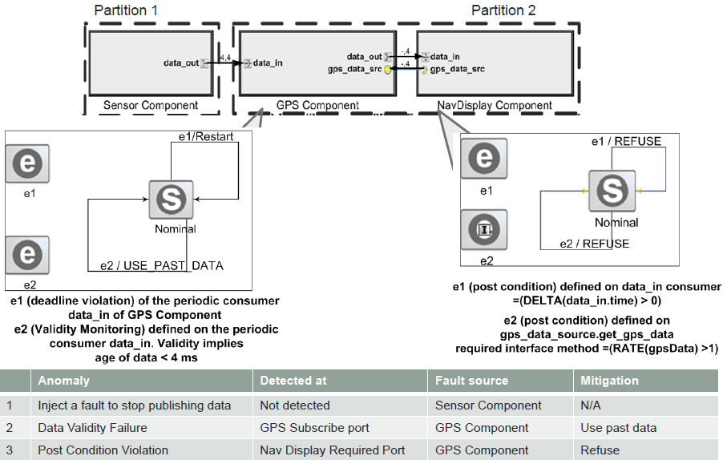
CLHM Example

Slide 26
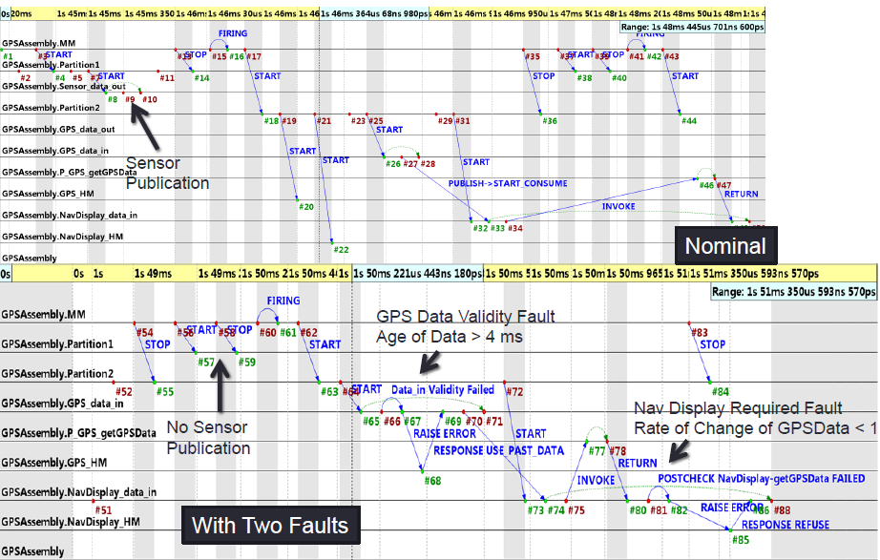
Sequence of Events: Local Fault Detection & Mitigation

Slide 27
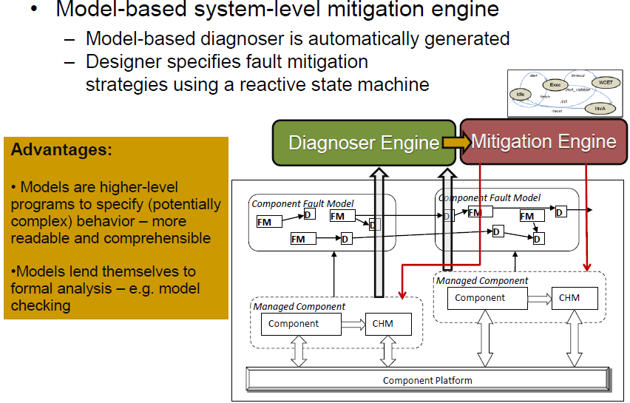
System-level Fault Mitigation

Slide 28
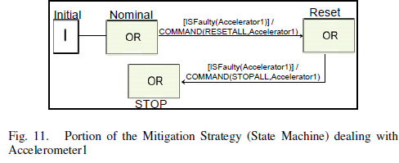
SLHM Strategy Example
An initial command is issued to RESET the Accelerometer component, hoping that this will get the Accelerometer to work correctly.
If despite the reset, the same Accelerometer is identified as a fault-source within a specified time-limit, then command is issued to STOP the Accelerometer.

Slide 29
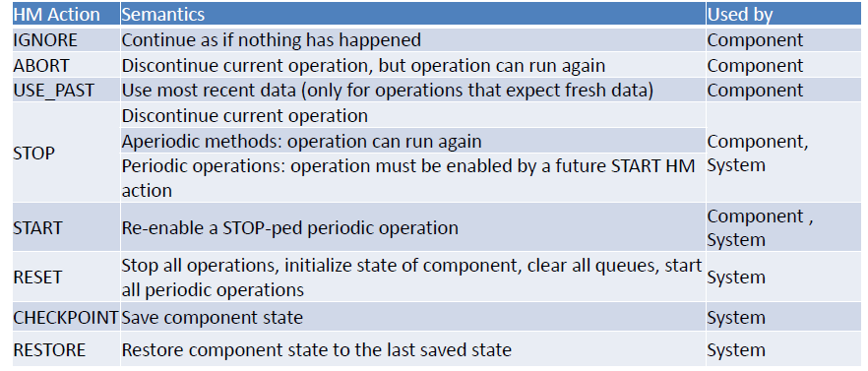
Health Mitigation Actions

Slide 30
FAILSAFE Project Software Health Management
Matthew R. Barry, PhD, PE
Principal Investigator
Kestrel Technology, LLC
January 2008

Slide 31
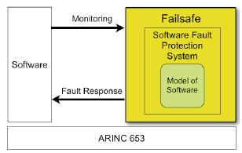
FAILSAFE Overview
Integrate various models of software performance and fault recovery to provide system-level software health management capabilities under ARINC 653 for high-assurance applications

Slide 32
Problem Addressed
Current failure recovery strategies prescribe limited actions in response to error conditions
reboot or failover to backup hardware
FAILSAFE proposes finer-grained granularity of fault protection, such that failures in a subsystem are isolated while the rest of the flight software continues to operate normally
e.g., monitor memory allocation to identify a component with memory leaks before memory is exhausted, and restart the faulty component.
Notes:
., in current practice
the response to an out-of-memory error may be a processor
reboot. In FAILSAFE the fault protection system will

Slide 33
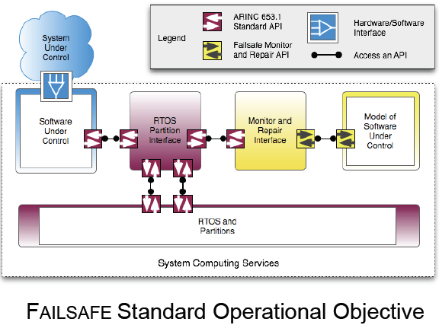
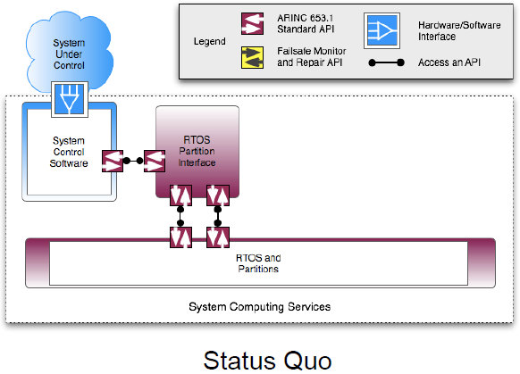
FAILSAFE Framework Components

Slide 34
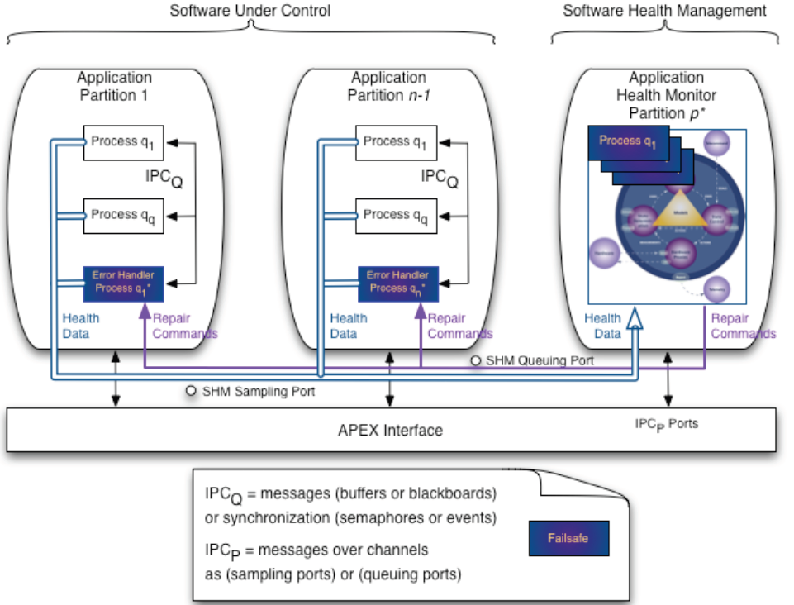
FAILSAFE Framework

Slide 35
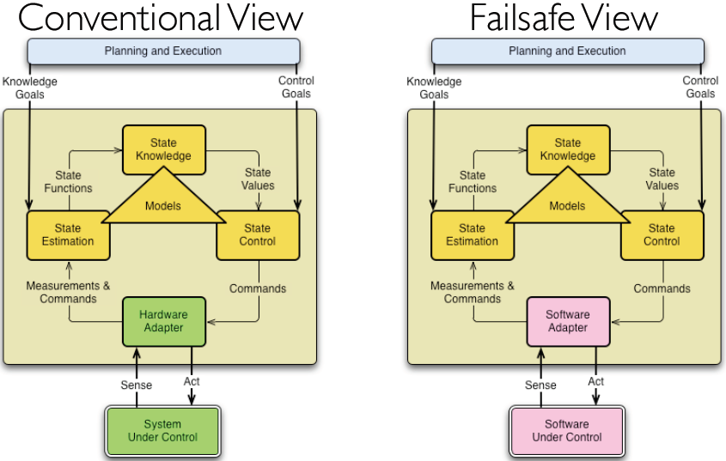
Mission Data System (MDS)
MDS has three parts:
An information and control system architecture
A systems engineering methodology
Reusable and adaptable framework software

Slide 36
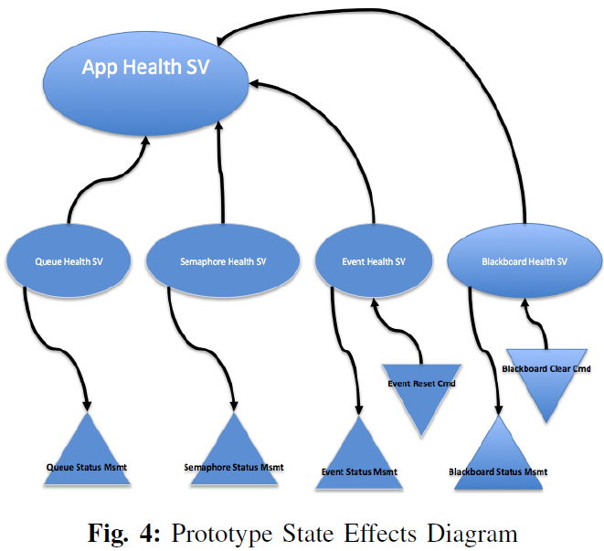
State Effects Diagram

Slide 37
Demo Application
Shuttle Abort Control System (ACS) application running under the Wind River Systems VxWorks, or Vx653. There are 3 partitions:
Application itself runs in 2 partitions, one partition allocated to the sequencing behavior and one partition allocated to I/O.
HM runs in its own partition.

Slide 38
Caroline Lu, Jean-Charles Fabre, Marc-Olivier Killijian: Robustness of Modular Multi-layered Software in the Automotive Domain: a Wrapping-based Approach. ETFA 2009: 1-8

Slide 39
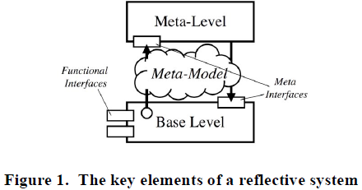
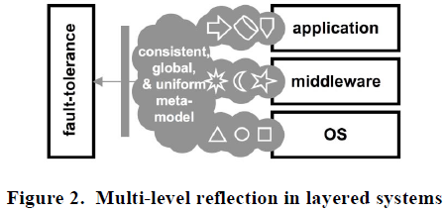
Reflective System
Computational reflection refers to a computing system’s ability to reason about and act upon itself.
A reflective system distinguishes between a base level, where the system’s primary functions are implemented, and a meta-level, where computation about the base level takes place
Notes:
Originally proposed in the context
of programming languages [1], reflection can be applied to
solve elegantly a range of cross-cutting computational problems,
from tracing, and encryption, through to hardening in real-time
OSs [2], and replication [3,4,5,6]. It can also be credited to have
strongly influenced novel programming practices such as aspect
orientations. In architectural terms, a
(guiding a rocket, computing a braking profile, processing a payroll)

Slide 40
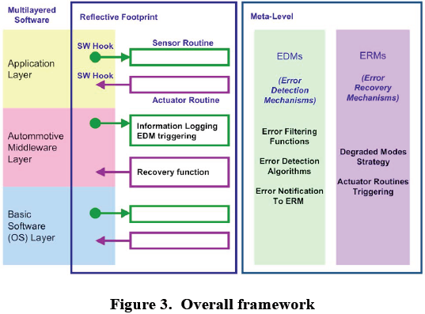
Defensive SW Framework

Slide 41
Logging Infrastructure: Bracket Tables
The execution trace from OS viewpoint:
when a critical task starts execution, an “opening-bracket table” entry is filled basically with the task identifier and a timestamp. The “closing-bracket-table” stores the same type of information, when the task ends
The execution trace from application viewpoint:
when a critical application-level function starts and ends.
The control event trace:
when an activation event (that impacts directly or indirectly the activation of a task) happens, an “opening-bracket-table” entry is filled basically with parameters that characterize the event, the current running task identifier, and a timestamp. The “closing-bracket-table” stores the same type of information, when the termination event occurs.
The data event trace:
when a critical data is written, an “opening-bracket-table” entry is filled basically with the data, the function identifier that produces the data, the task identifier in which it runs and a timestamp. The “closing-bracket-table” stores the same type of information, when the data is read.

Slide 42
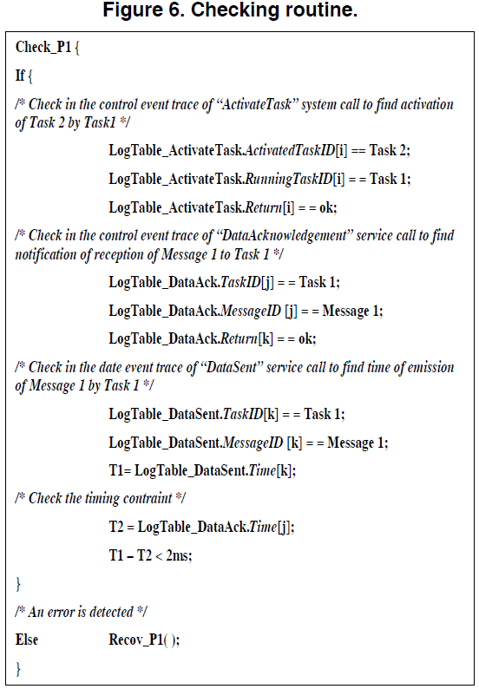
Error Detection
Example Property to be checked
“Acknowledgement of reception of Message 1, notified to Task 1, at latest 2ms after Message 1 has been sent, allows Task1 to activate Task 2, else Task 3 must be activated”.

Slide 43
Error Recovery
Each “checking routine” is associated with one or more “recovery routines”.
Recov_P1
{/* Error: Task 2 must not be activated but Task 3 */
ActivateTask (Task3); }
Control flow error recovery.
Dataflow error recovery

Slide 44
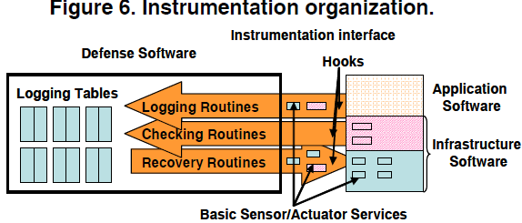
Instrumentation
Two types:
Hooks
invoked by the OS at specified times, such as tasks context switch, startup, shutdown, or detected errors.
Basic services (sensor & actuator)
Notes:
“GetScheduleTableStatus”, “GetCounterValue”,
“GetElapsedCounterValue
”).

Slide 45
Basic Services
Basic sensor services
OSEK defines the running task identifier (“GetTaskID”), the task state (“GetTaskState”), the current state of event mask of a task (“GetEvent”), alarm characteristics (“GetAlarmBase”, “GetAlarm”), and the current mode (“GetActiveApplicationMode”).
AUTOSAR defines additional interfaces : “GetISRID” to get the identifier of interrupt routines, “GetApplicationID” to get the identifier of a sort of partition (if the OS uses memory protection), and information about predefined schedule tables.
Basic actuator services
Control flow
Dataflow

Slide 46
Control Flow Recovery Strategy
Actions on control flow concern the life cycle of tasks and can be classified into 3 categories:
End of task execution:
terminate the erroneous task.
Start of task execution:
launch a degraded task if switch to degraded mode is decided; or to launch the expected task after error detection on sequence of execution; or else to launch again the same task from the beginning
Suspension of task execution:
temporarily stop the current execution, to allow the execution of another action/task.
Notes:
to reexecute the same treatment with right entries. The
activation of a task may be synchronous or
asynchronous.
·

Slide 47
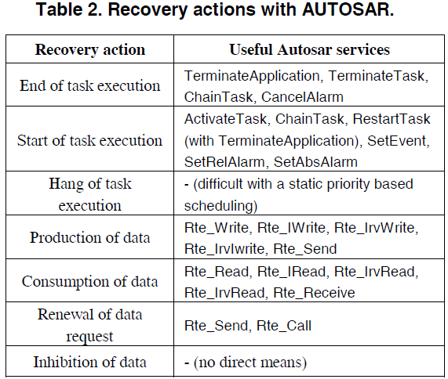

Slide 48
Data Flow Recovery Strategy
Actions on data flow relate data value or timing:
Production of correct or degraded data:
Overwrite the preceding erroneous data by the right one.
Consumption of correct or degraded data:
Call the data consumption instruction again to get the correct value which is has been updated by the recovery strategy.
Renewal of data request:
Call the data production or consumption instruction again, when timeout reception or acknowledgement of emission is missed.
Inhibition or delay of data:
When invalid or untimely data is received, the recovery strategy acts a filter, to transmit only right data to the application.

Slide 49
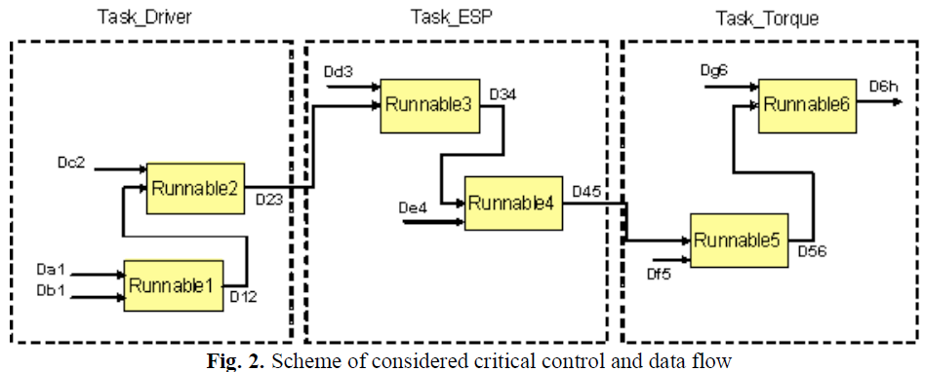
Application Example

Slide 50
Control and Data Flow Assertions
Control flow assertion
At Execution Control Point, critical sequences of execution are expected
The expected periodic atomic sequence pattern are S1= {Runnable1, Runnable2}, S2= {Runnable3, Runnable4}, S3= {Runnable5, Runnable6}. If S1 or S3 atomic sequence is broken, it has to be re-executed. If S2 is broken, degraded values are taken.
Dataflow assertion
At Execution Control Point, several critical data must be all produced before being consumed.
Each runnable must have its inputs available before it can run. If the produced data is inconsistent with the consumed data, the logged data is taken as an input. If the produced data is invalid, a default value is taken.
Notes:
Before S3, if S1 is older than 4 executions of S2, S1 must be re-executed before S3.

Slide 51
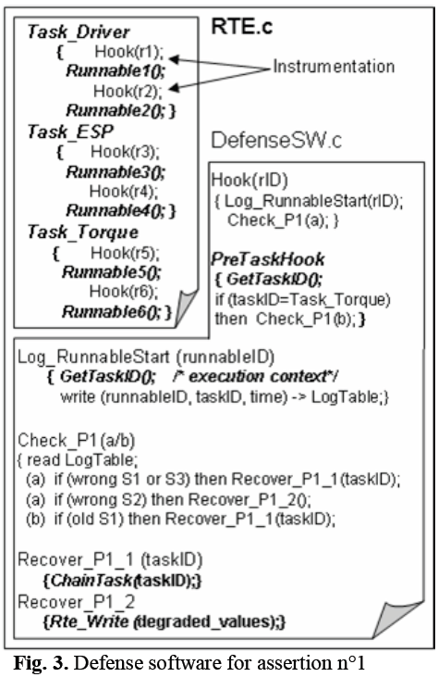
Error detection
Check_P1()
Error recovery
Re-execution of runnables is implemented by the “ChainTask” OS service, that terminates the current task and activates the requested one.
Decision to take default value is realized by a “Rte_Write” RTE service
Hooks
Use OS hooks routines: “PreTaskHook” and “PostTaskHook”, that occur at each context task switch.

Slide 52
Comparisons
 | Model-based HM (Dubey et al) | FAILSAFE (Barry et al) | AUTOSAR-Based (Lu et al)
Application domain | Aerospace (ARINC 653) | Aerospace (ARINC 653) | Automotive (AUTOSAR)
Property Specification | Temporal Logic | Temporal Logic | Informal
SW Sensors | Logging | Logging | Logging tables
Fault Diagnosis | TFPG | State-Effects Diagram | None
SW Actuators | ARINC 653 API | ARINC 653 API | AUTOSAR API

